Slide 1
CS3391Object Oriented Programming
Dr.D.Sivaganesan, Professor,
PSGiTech / CSE

Slide 2
Java Development Kit
javac - The Java Compiler
java - The Java Interpreter
jdb- The Java Debugger
appletviewer -Tool to run the applets
javap - to print the Java bytecode
javadoc - documentation generator
javah - creates C header files

Slide 3
Structure of Java Program
Comments Section
Import / Package section
Class definition
Main class definition with main method

Slide 4
Simple Java Progarm
class Simple
{
public static void main(String args[])
{
System.out.println(“Hello Java World");
}
}
Keyword class to create a new class followed by class name

Slide 5
main( ) method definition
public – access modifier
static – allows main() to be called by all objects
void – return type
main – called when java application begins
String args[] – array of instances of class String
System – predefined class
out – output stream connected to the console
println – println() displays the string passed to it

Slide 6
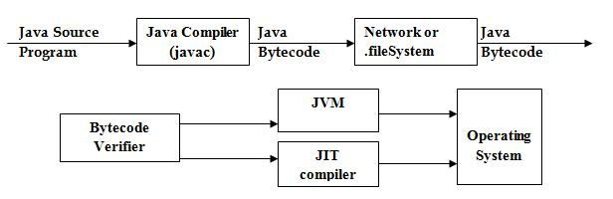
Compiling and Running of Java Code
Stage 1 :
Stage 2 :

Slide 7
Compiling and Running of Java Code
Java Source file:
Notepad –any editor
Case Sensitive
filename.java (Extension)- it should be main class name
To Compile and Run the Program:
1. Source file : Simple.java
2. To compile : javac Simple.java
3. It Produces Simple.class file(byte code version).
4. To run : java Simple

Slide 8
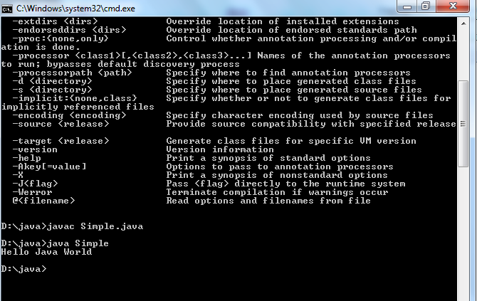

Slide 9
Steps to install jdk 1.7
Copy the jdk 1.7 into c:\prgram files \java of your system
Select my computer ->properties->Advanced system setting
Select environment variable
In system variable window select new button
In text box type path and in value textbox copy jdk 1.7 bin file.
ie. C:\Program Files(x86)\Java\jdk1.7.0_21\bin;
In system variable window select new button
7. In text box type Classpath and in value textbox copy jdk 1.7 lib file.
ie. C:\Program Files(x86)\Java\jdk1.7.0_21\lib;

Slide 10
Thank you

